Slide 1
Surface Energy Budget
Tilden P. Meyers
NOAA/OAR/ARL/ATDD
6/22/2016

Slide 2
Global Energy and Water Cycle Experiment
Determine the hydrological cycle and energy fluxes by using measurements of atmospheric and surface properties.
Model the global hydrological cycle and its impact on the atmosphere, oceans and land surfaces.
Develop the ability to predict the variations of global and regional hydrological processes and water resources.
Advance the development of observing techniques, data management, and assimilation for long-range weather forecasts, hydrology, and climate predictions.

Slide 3
Our Objectives for the
Surface Energy Budget Network (SEBN)
To improve predictions of water (precipitation, soil moisture, evapotranspiration) from days to months by focusing on a predictive understanding and response of the land surface to significant climate events for major land-use types in the U.S.

Slide 4
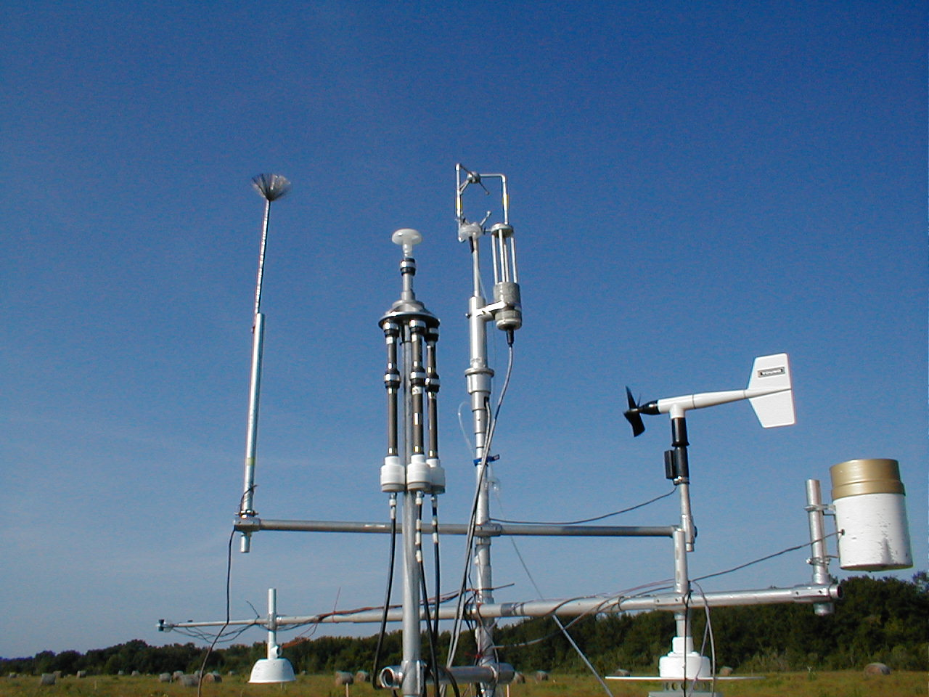
ARL/ATDD recognized as a leader in air-surface exchange measurements
ARL/ATDD led development of open path H₂O/CO₂ gas analyzers

Slide 5
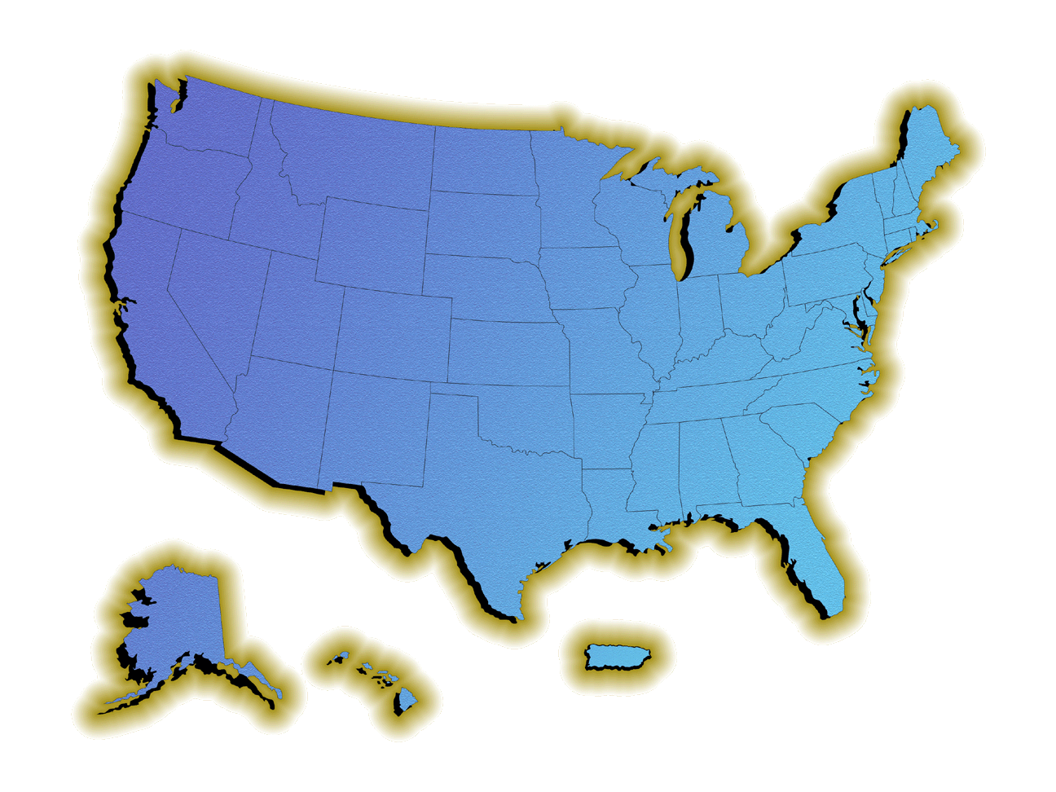
SEBN Full Network (1995 – 2016)
Representative Land Use in Major Climate Regions
1996
2005
2002

Slide 6
SEBN Site Configuration

Slide 7
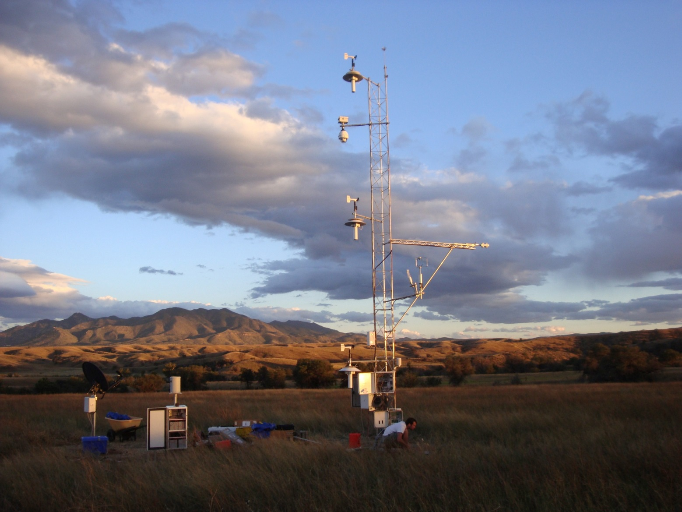
Grasslands
Audubon Research Ranch, AZ
Notes:
With an objective of obtaining data over representative ecosystems, no two stations are quite the same, each having a unique set of challenges.

Slide 8
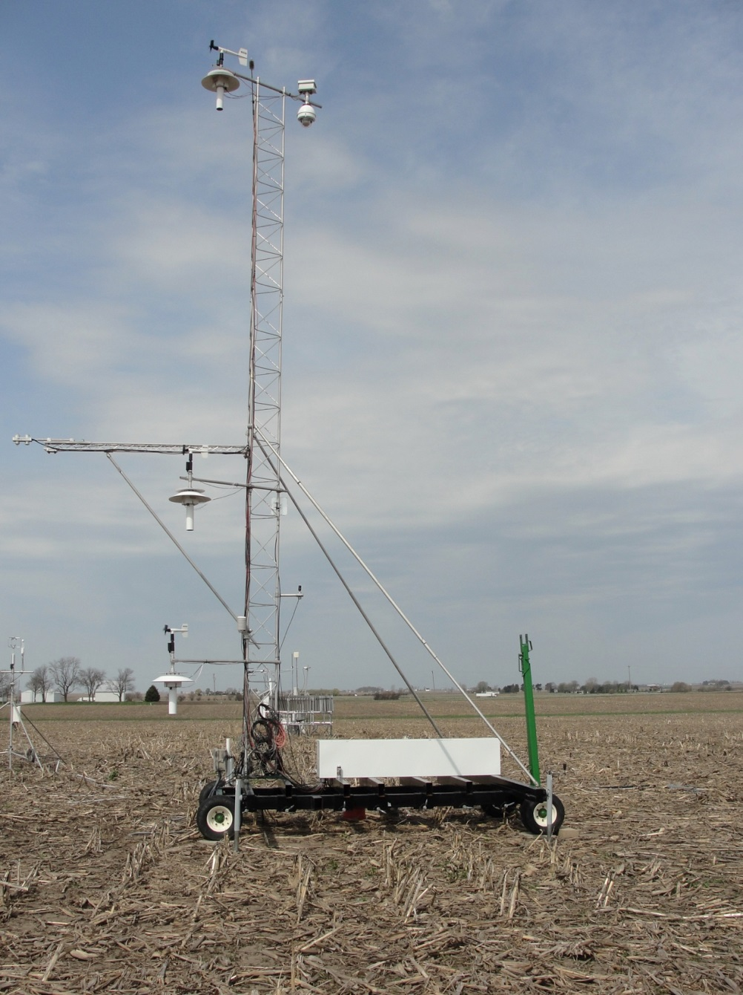
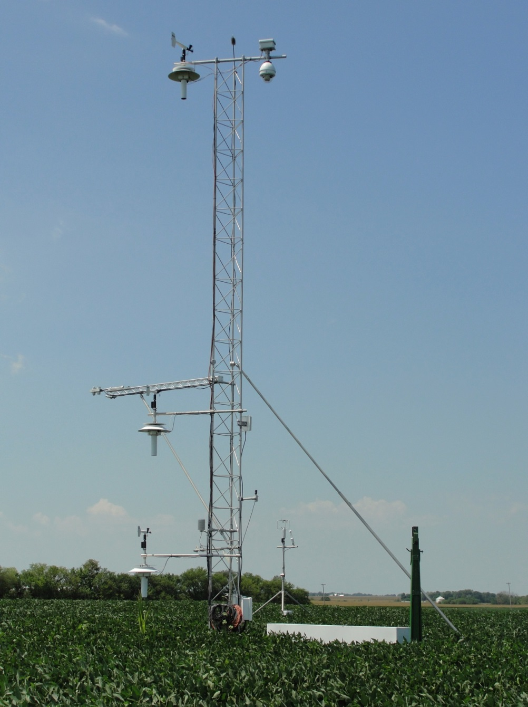
Croplands Champaign, IL (Bondville)

Slide 9
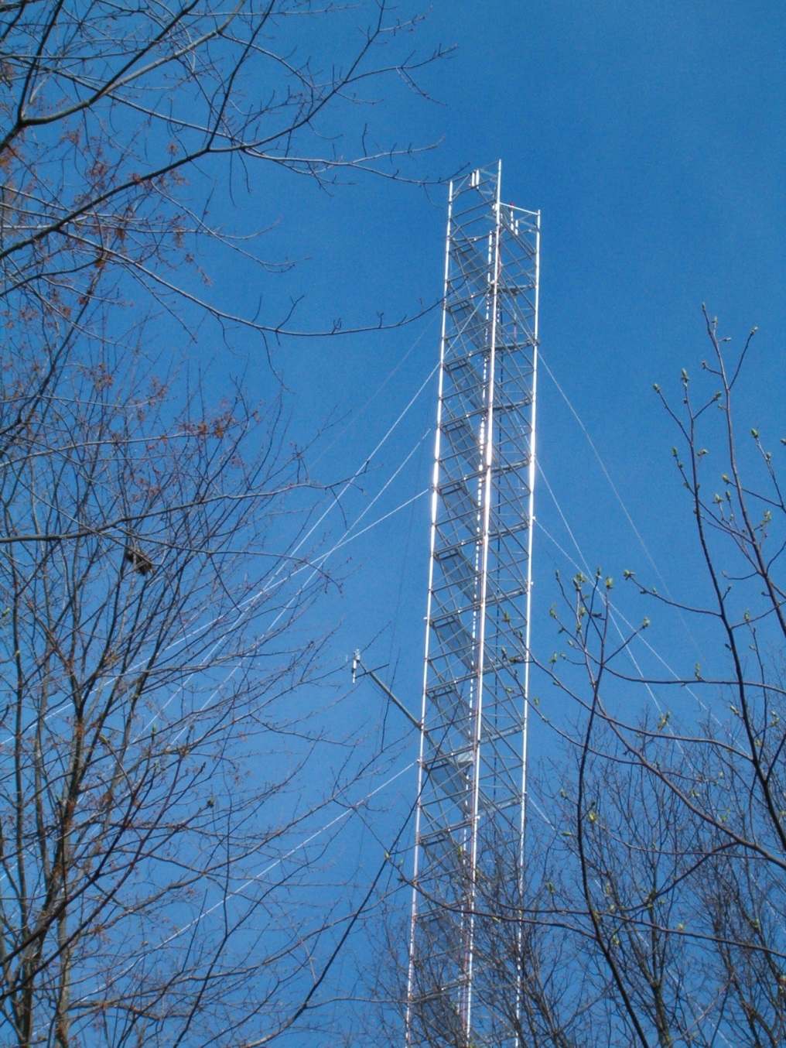
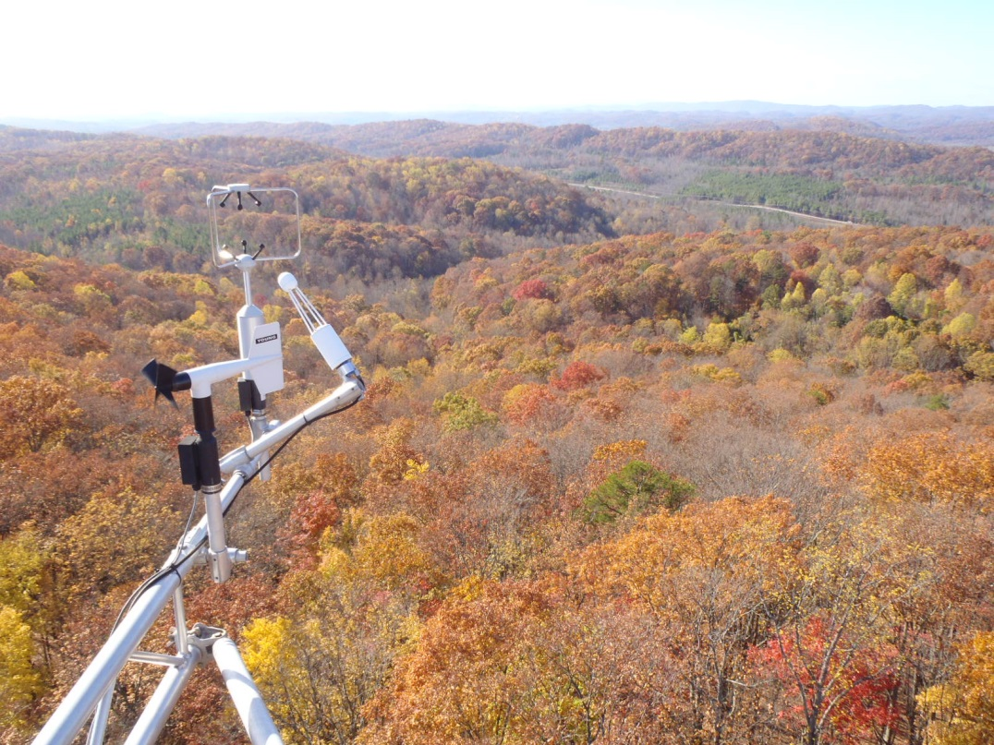
Forest Oak Ridge, TN
60 m walk-up tower platform
Additional measurements on smaller tower systems at the base of the forest

Slide 10
The Surface Energy Budget
H + LE + G + Ps = Net Radiation
Surface Radiation Budget
Surface heat budget
infrared
Sensible heat (H)
infrared
Evapotranspiration (LE)
net solar
infrared
Photosynthesis (Ps)
Conduction (G)
Notes:
The surface energy budget goes a step beyond by examining how the absorbed radiation (net) radiation at the surface is partitioned into sensible, latent (ET), ground and photochemical energy.

Slide 11
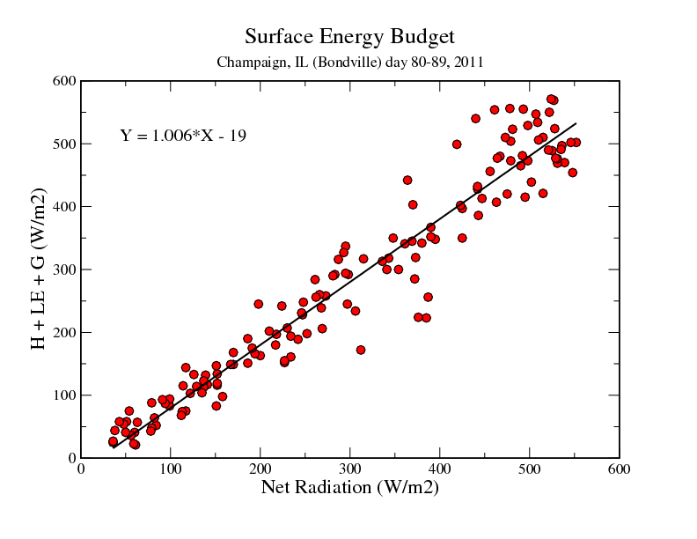

Slide 12
Benefits
Improved parameterizations of the land surface model physics that ultimately improves seasonal predictability of water resources
Better understanding of the critical land surface processes that control the seasonal and annual water and carbon budgets for various ecosystem types and the impacts of extreme climatic events on the land surface responses
Leveraging this expertise to support validation efforts in NOAA’s water initiative
Notes:
Measures of Success, value of observations, more reason to continue and sustain these obs.

Slide 13
Partners and Collaborators

Slide 14
Quality, Relevance, Performance
NOAA sponsored sites constitute approximately 12% of the present AmeriFlux database.
Data are used by NCEP Land Surface Modeling group for testing and evaluation purposes.
Bondville, IL is one of only 6 active AmeriFlux sites with records dating to 1996 and represents the longest continuous AmeriFlux record in an agricultural system. This year will mark 20 years.
Over 50 authored or co-authored publications (ARL scientists) over the last 10 years, with over 200 publications that have used this data for assessments and synthesis activities.
Notes:
Measures of Success, value of observations, more reason to continue and sustain these obs.

Slide 15
Major Highlights
Mid-western corn/soybean ecosystems small carbon sink (Bernacchi, Hollinger, Meyers, 2005)
Significance of ecosystem storage terms in closing the surface energy budget (Meyers and Hollinger, 2004)
Demonstrated use in-situ broad-band Normalized Difference to track leaf area index (Wilson and Meyers, 2007)
Characterized evapotranspiration for semi-arid grasslands -AZ (Krishnan et al, 2012)
Sonic Anemometer biases ~ 15% (Kochendorfer et al, 2013)
Utility of land surface temperature from in-situ network (Krishnan et al, 2015)

